Slide 1
World Conference of Science Journalists 2027 (WCSJ27)
Building Global Networks for a Stronger Profession

Slide 2
The proposal
For the Association of British Science Writers (ABSW) to host the World Conference of Science Journalists in London in September 2027 – the ABSW’s 80th anniversary year.

Slide 3
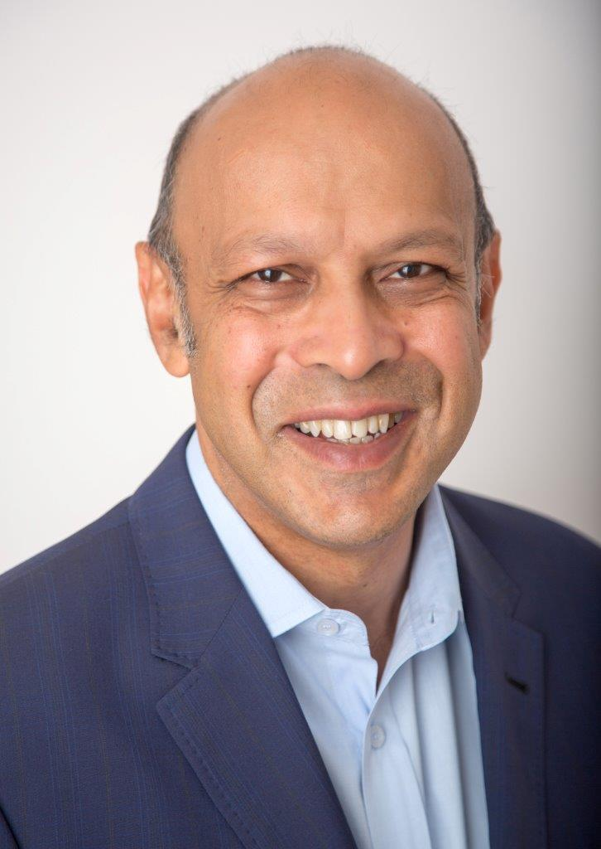
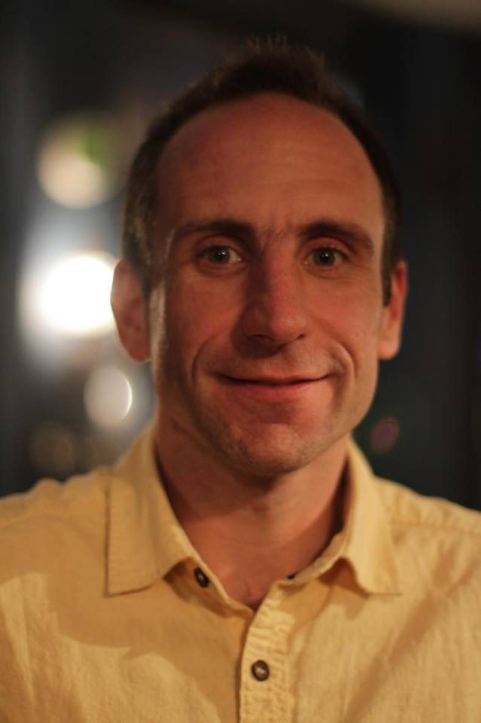
Science journalists have a vital role to play in informing millions of people around the world about the latest advances and controversies in science and technology. The ABSW would like to once more welcome journalists, editors and science communicators from around the globe to London to share experiences, develop new contacts and report great stories at WCSJ27.
Pallab Ghosh, Honorary President, ABSW
With over 700 members and a strong track record of organising conferences, the Association of British Science Writers is well equipped to welcome delegates from everywhere to the World Conference of Science Journalists 2027. Likewise, London is a dynamic, globally connected city, with a long scientific history. It offers something for every attendee.
Andy Extance, Chair of the ABSW

Slide 4
Scope and size
A hybrid event for up to 1000 in person delegates and up to 500 more remote delegates
Proposed date: September 2027
One day of pre-conference skills building workshops for those awarded diversity and inclusion scholarships (n= 100)
Tuesday – Thursday main conference sessions including plenary sessions and four parallel sessions
Friday – post conference tours and visits both in the UK and Europe

Slide 5
Post conference tours and visits
Joint European Torus - the focal point of the European fusion research programme
Jenner Institute - where the Oxford/Astra/Zeneca Covid-19 jab was developed, and development site for the Pandemic Sciences Institute
European Space Agency HQ in Paris (via Eurostar)
Bletchley Park - site of Britain’s world war two code breakers
CABI genetic resource library - houses Alexander Fleming's first strain of penicillin
Jodrell Bank - home to the Grade 1 listed Lovell Telescope
Royal Botanic Gardens, Kew - with over 350 scientists, Kew’s mission is to understand and protect plants and fungi for the well-being of people and the future of all life on Earth
The Science Museum - behind the scenes tour of full collection (Science Museum Energy Hall pictured left copyright Science Museum)
The Natural History Museum - meet some of the 300+ scientists who work in the museum’s earth and life sciences, their core research labs and library and archives.

Slide 6
Social programme
Monday – Media Reception for scholars to meet key science journalists.
Tuesday – Welcome Reception
Wednesday – Gala reception
Thursday – Farewell Reception
Landmark venues for the receptions could include, The Science Museum, The Natural History Museum, The Francis Crick Institute, The Royal Society, providing delegates the opportunity to visit these key scientific and historic London institutions.

Slide 7
Legacy
WCSJ27 will inspire and cultivate global networks around key topics such as global health, climate change, and water. This could be achieved by having continent-based themes with cross-cutting topic-based events and networking opportunities bringing together speakers and delegates. The ABSW would work with SciDev.Net on a series of post conference planned legacy events focused on strengthening the global networks established in London.

Slide 8
A track record of success
The ABSW hosted the World Conference of Science Journalists in London in 2009 (WCSJ09)
Over 1000 participants were involved in this event, target was 600
The event supported over 100 scholars to attend the conference
Sponsorship targets were exceeded for the main conference, the target was £445k and we reached nearly £490K
At the time the programme was commended as the best WCSJ programme ever
ABSW and WFSJ both received huge profile from the event that has been capitalised on going forward
The event made over £80k surplus

Slide 9
UK Conference of Science Journalists
The success of the WCSJ09 in London led to the ABSW introducing its own biennial conference the UK Conference of Science Journalists (UKCSJ). This one-day conference has gone from strength to strength. The last UKCSJ was held in 2022 at the Francis Crick Institute, London:
Theme - Science reporting post pandemic: Lessons learned, changing working practices, next big stories
Fully hybrid event
Nearly 200 delegates - 75 in person
Plenary speakers: Sir Jeremy Farrar, Director of Wellcome; Anjana Ahuja, the Financial Times’ award-winning science columnist; Sirin Kale, Investigative Journalists and Feature Writer for the Guardian
Two strands: ‘Skills and tools’ & ‘Trends and innovation’
Sessions on diversity, combatting scientific misinformation and investigative journalism.

Slide 10
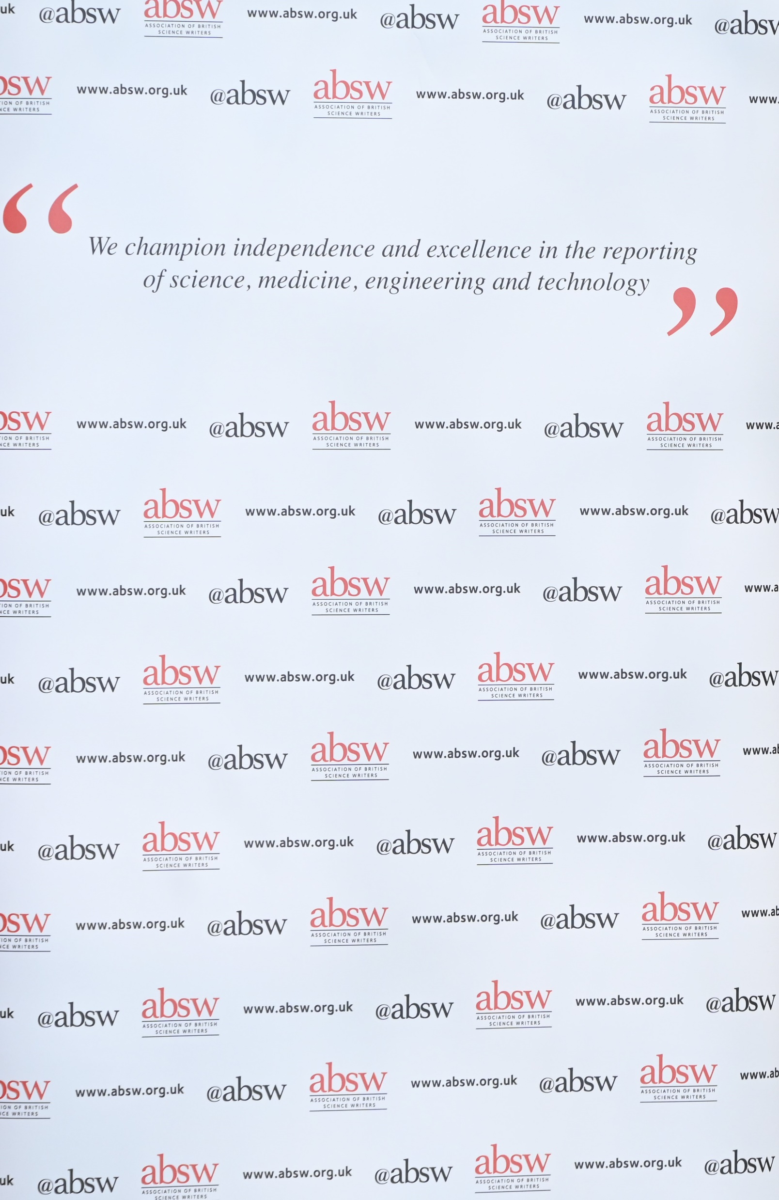
Why the ABSW?
The Association of British Science Writers, established in 1947, exists to champion independence and excellence in the reporting of science, medicine, engineering and technology.
We support journalists and writers at all career stages through an annual calendar of conferences, summer schools, networking events, awards, fellowships, mentoring and professional resources.
Since our first meeting in March 1947 at 5 Old Burlington Street we have gone from strength to strength and now have a dynamic membership of over 700 science writers and journalists.
We have a track record of success in holding international and national events and conferences that attract significant sponsorship and an impressive array of speakers and expert trainers.
We strive for diversity and inclusion through fully funded scholarships to our major events and through our policy on gender equality of speakers and moderators at conferences. We also take a strong view on harassment through our harassment policy. These policies will be reviewed and reflected in our plans for WCSJ27.

Slide 11
Why London?
Unique spaces - More than 1,000 diverse conference venues and 140,000-plus hotel rooms across the capital. The ABSW has already identified three potential venues:
The Barbican - https://www.barbican.org.uk/hire/venue-hire#venues
Central Hall Westminster (venue for the WCSJ09) - https://www.c-h-w.com/events/conferences
Excel - https://www.excel.london/organiser/venue-spaces
Connectivity - With six international airports and direct flights to 400 destinations, London is one of the best-connected cities worldwide. It is an easy city for delegates to reach and an easy place to navigate once they're here.
Diversity - No other city on the planet matches London for its wealth of culture and rich heritage. With 233 different languages spoken and a great variety of cuisine, music and entertainment, London’s diversity provides a friendly welcome.
Quality - London is home to cutting-edge industry clusters, world-renowned galleries, museums, and Michelin-starred restaurants. The capital is leading the way in innovative event concepts.
Reference: ‘Visit London’

Slide 12
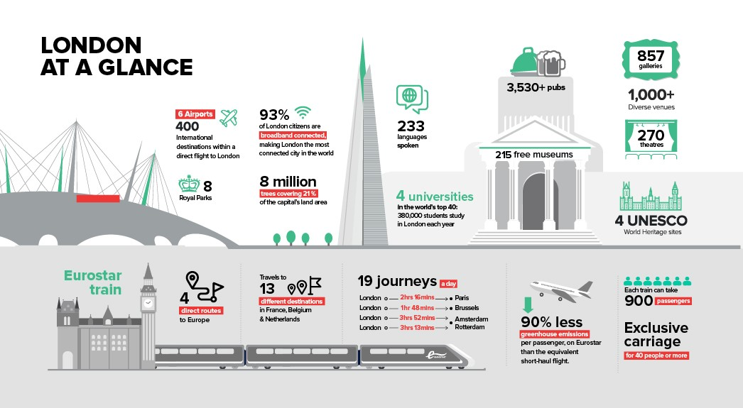

Slide 13
Sustainability in London
Getting here
London Heathrow Airport is the largest user of sustainable aviation fuel (SAF) in the world, with incentives in place encouraging more airlines to switch to SAF. Similarly, London City Airport is committed to becoming the city's first net zero airport and is ensuring sustainability is the cornerstone of its expansion plans. Additionally, low-carbon rail links to mainland Europe make the city easily accessible.
Travel and transport within London
The extensive Tube network, 807 electric and 4,661 hybrid buses, 20 hydrogen-fuelled double-decker vehicles and 4,400 electric taxis all make London a city of sustainable transport options. Recent innovations include London's Elizabeth line, which is more carbon efficient than the rest of the Tube, and the rollout of Uber Green, which allows passengers to book rides in 100% electric vehicles.
Green space
London is the world’s first National Park City. At present, 45% of the city is open green space, with plans to increase this to 50% by 2050. The capital is a city for walkers, cyclists, and public transport users.
Hotels and venues leading the way
The Green Tourism scheme champions the hotels and hospitality venues prioritising sustainability. Its 120+ members include gold award-winning hotel groups and iconic conference centres.
Eco-conscious event spaces
Major London events venues, including ExCeL London and Olympia London, are accredited for their commitment to reducing the environmental impact of the events they host.
Food waste
London’s caterers can provide locally sourced, sustainable food and drink options for small and large-scale events. Partnerships with redistribution projects and waste-reducing initiatives help to minimise unnecessary excess and expenditure.
Reference: London Convention Bureau

Slide 14
Science in the UK
Science and technology in the United Kingdom has a long history, producing many important figures and developments in the field. Major theorists from the United Kingdom of Great Britain and Northern Ireland include Isaac Newton whose laws of motion and illumination of gravity have been seen as a keystone of modern science and Charles Darwin whose theory of evolution by natural selection was fundamental to the development of modern biology. Major scientific discoveries include hydrogen by Henry Cavendish, penicillin by Alexander Fleming, and the structure of DNA, by Francis Crick and others. Major engineering projects and applications pursued by people from the United Kingdom include the steam locomotive developed by Richard Trevithick and Andrew Vivian, the jet engine by Frank Whittle and the World Wide Web by Tim Berners-Lee. The United Kingdom continues to play a major role in the development of science and technology and major technological sectors include the aerospace, motor and pharmaceutical industries.
The UK continues to be a global powerhouse of science and research. With many universities at the cutting edge of global discoveries and emerging technology. UK universities continue to be globally recognised for their commitment to research. The UK is ranked third in the world for published scientific research, with nearly 200,000 citable publications in 2020 alone.
The UK is home to four of the top ten ranked Universities, two within London - University College London, and Imperial College, London - and University of Oxford and University of Cambridge, both within easy reach of London. All will be explored as key sites of interest for post conference trips.

Slide 15
A Professional Team
The ABSW Executive Secretary Sallie Robins (pictured left), was one of the two Conference Directors for the WCSJ09 and was instrumental to its great success. Her experience of directing the 2009 event and of running all ABSW’s major conferences since will put the management of WCSJ27 on a strong footing from the outset.
Pallab Ghosh who at the time of the WCSJ09 was the President of the World Federation of Science Journalists will also be instrumental to our further success in 2027 and will form a key member of the management structure behind the WCSJ27. Pallab is currently BBC Science Correspondent and the ABSW’s Honorary President.
The ABSW will appoint a Professional Conference Organiser (PCO) as this will be essential to identifying an appropriate venue and conference hotels and to negotiating hard on rates to keep the registration costs for delegates affordable and appropriate.

Slide 16
Proposed management structure for WCSJ27
Conference Director(s): responsible for oversight of all elements and instrumental in obtaining sponsorship funding.
Professional Conference Organiser: responsible for logistics and for developing and delivering sponsorship packages.
Steering Group: Leading science journalists and editors to give kudos to the event and to assist in attracting top level speakers and sponsors.*
Executive Organising Committee: A management committee for the WCSJ27.
Programme Committee: To manage the development of a top-level programme of sessions and workshops*
In 2009 the ABSW established a limited company to manage the WCSJ09 and to limit the risks to the ABSW (which is also a limited company) – the ABSW will consider this approach for the WCSJ27 after taking appropriate legal advice.
*The Steering Group and Programme Committee will include representatives from the WFSJ and other associations in membership of the WFSJ particularly the global south.

Slide 17
Programme Development
The ABSW will appoint a Programme Committee to develop an excellent programme of plenary, parallel and workshop sessions. There will be an open call for session/workshop proposals to all member associations of the WFSJ to ensure that all associations can propose and organise sessions that reflect their current priorities, professional concerns and skills building needs. Slots in the programme will be held to ensure that breaking news and issues can have a place in the programme.
Diversity and Inclusion
The ABSW strives to make all its events inclusive and the WCSJ27 will be no different. We will endeavour to establish at least 100 fully funded scholarships available to all science journalists from around the world. As well as setting criteria for affordability the scholarships will also look at issues of inclusion to ensure that those from underrepresented groups in science journalism are prioritised and assisted in attending.

Slide 18
Marketing and Media
A media partner would be sought at an early stage to help publicise the WCSJ27, for WCSJ2009 this partner was SciDev.Net with whom the ABSW still has strong links such as Ben Deighton, Editor of SciDev.Net, who is on the ABSW Executive Board. Most recently the ABSW has worked with AlphaGalileo as media partner for the ABSW Annual Awards. These ‘in kind’ relationships generate significant publicity at low cost to the organisers.
A team of writers and broadcasters will be engaged to provide daily online coverage of the conference with video, podcast, and written content. All sessions will be recorded and this along with the daily coverage will provide a lasting resource for the ABSW and the WFSJ.
Press Briefings
A series of press briefings will be organised so that journalists attending can file stories whilst at the conference.
A Fully Connected Conference
Hybrid event that allows online participants to fully participate in discussion, debate, and networking.
Conference app to enable easy access to programme information, speaker biographies and for networking and contacting other delegates.
Dedicated conference website and social media channels

Slide 19
Budget
Based on costs for the 2009 event it is predicted the WCSJ27 will cost in the region of £1,270,000. The ABSW would aim to raise 60% of this cost through sponsorship and 40% through delegate fees. This would mean an ambitious but achievable sponsorship target of £762,000.
Delegate Fee Structure
The ABSW proposes a tiered fee structure.
1 Commercial Organisations
2 NGO/Charity/Academic
3 Journalists not in membership of WFSJ associations
4 ABSW members and members of other WFSJ associations
5 Students
Delegates will either pay for a day ticket or for the full main conference (Tue-Thu) with cost savings for buying the full ticket.
Early bird rates will also provide further discounts on all ticket tiers.
The ABSW will aim to fund 100 fully funded scholarships.
Visits will be fully funded and at no cost to delegates as organisations will be asked to cover the costs of bringing delegates to their venue/research establishment.

Slide 20
Organisations supporting the ABSW bid .
This list is not extensive but demonstrates the level of support the ABSW can achieve in a short space of time. Many organisations have complex decision-making structures and could not agree on support in such a short time scale, but the ABSW is confident that all key Institutions will come on board as plans for the WCSJ27 develop.
CABI (Centre for Agriculture and Bioscience International)
Chemistry World
European Federation for Science Journalism
The Guild of Health Writers
The Medical Journalist’s Association
National Coordinating Centre for Public Engagement (NCCPE)
Nature
Physics World
The Royal Institution of Great Britain
SciDev.Net
The Science Communication Unit, University of the West of England
The Science Museum
UK Research and Innovation

Slide 21
ABSW Directors and Board members
Directors
Andy Extance, Chair - freelance science writer
Alex O’Brien, Vice-Chair - science writer & author
Aisling Irwin, Secretary - freelance science journalist
JV Chamary, Treasurer - science communicator & award winning journalist
Board Members
Sam Bronheim – Student Representative, award winning student journalist
Ben Deighton – European Representative, Managing Editor, SciDev.Net
Ehsan Masood, Editorials Editor, & Bureau Chief for Africa and the Middle East, Nature
Andy Ridgway, Lecturer in Science Communication, University of the West of England
Katherine Rushton, Deputy Investigations Editor, The Telegraph
Angela Saini, award winning British science journalist and broadcaster
Katherine Sanderson, award winning science journalist & editor
Matthew Warren, Editor Research Digest, British Psychological Society
Bob Ward, Policy and Communications Director, Grantham Research Institute on Climate Change and the Environment, London School of Economics and Political Science

